Slide 1
ORIENTATION ON PMKVY SCHEME
Presented by: Johnbasha
Vignan
PMKK, Guntur

Slide 2
About PMKVY
Pradhan Mantri Kaushal Vikas Yojana (PMKVY), a flagship scheme of the Ministry of Skill Development & Entrepreneurship (MSDE), aims to empower Indian youth with industry-relevant skills for better livelihoods through skill certification and training.
Free Training and Assessment:
Training and assessment fees are fully covered by the government under this scheme.
Components:
  Short Term Training (STT): Provides skill development training.
  Special Projects: Addresses specific skill needs.
  Recognition of Prior Learning (RPL): Certifies existing skills and experience.
PMKK, Guntur

Slide 3
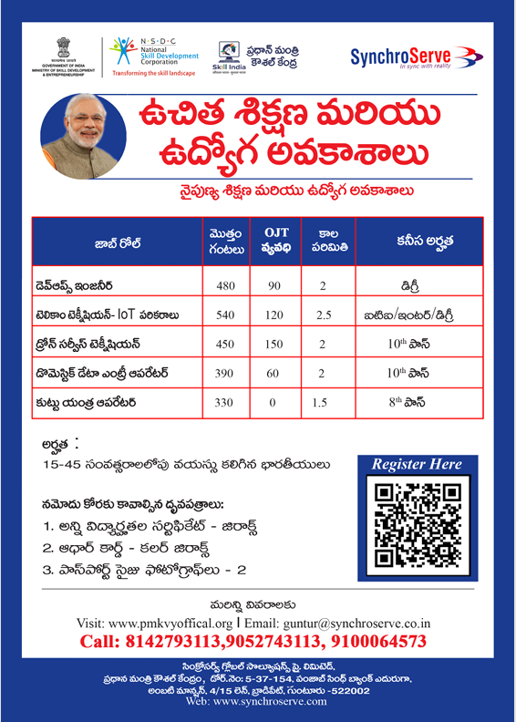
PMKK, Guntur

Slide 4
JOB ROLE : AI - DEVOPS ENGINEER
Sector : IT – ITES
Topic Name : “Overview of DevOps”
PMKK, Guntur

Slide 5
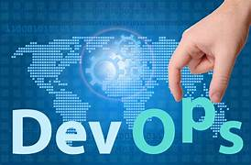
What is DevOps
Definition:
DevOps is a set of practices and tools used to automate deployment, improve software quality, ensure faster delivery, and enhance collaboration between development and operations teams.".
It is an approach designed to close the gap between software developers( who create the code), and operations teams, who manage the systems and infrastructure.
PMKK, Guntur

Slide 6
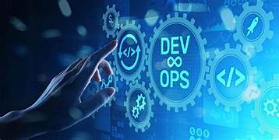
Core Principles of DevOps :
Collaboration: Bridging the gap between
development and operations teams.
Automation: Automating repetitive tasks like
code integration, testing, and deployment.
Continuous Integration & Continuous Delivery (CI/CD)
Ensuring code is always in a deployable state.
Feedback & Monitoring: Continuous feedback for constant improvement.
PMKK, Guntur

Slide 7
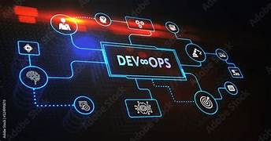
How Did DevOps Come Into Existence?
“The Evolution of DevOps in Software Development”
Traditional Development Model:
  Waterfall Model: A sequential approach where developers and operations teams work in silos (separately).
  Slow and Rigid: Long release cycles
  and delayed feedback loops.
  Communication Gaps: Lack of collaboration between development (Dev) and operations (Ops) teams led to inefficiencies, miscommunication, and slower delivery times.
Result: Bottlenecks in development and deployment cycles, causing friction between teams.
PMKK, Guntur

Slide 8
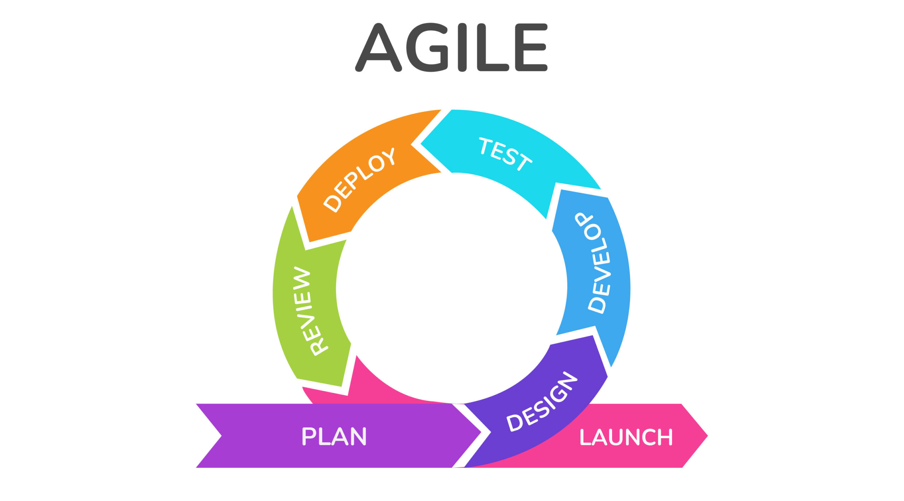
The Rise of Agile and Continuous Delivery:
Agile Methodology (2001):
  Focus on iterative development, rapid feedback, and cross-functional teams.
  Dev and Ops teams still worked separately, but Agile started emphasizing collaboration.
Challenges with Agile Alone:
  Despite faster development cycles, deployment
  to production remained slow and risky.
Continuous Delivery (CD):
  The need for faster, more reliable deployments led to the concept of Continuous Integration (CI) and Continuous Delivery (CD), streamlining the release process and reducing bottlenecks.
PMKK, Guntur

Slide 9
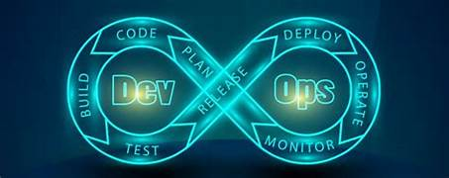
The Emergence of DevOps (2009)
Origins of DevOps:
Patrick Debois (2009): Coined the term "DevOps" after organizing the first DevOps Days conference in Belgium.
DevOps was born from the need to break down the silos between Dev and Ops teams.
DevOps aims to unify development, quality assurance,
and operations to enable faster, more reliable software
releases.
Milestones in DevOps History:
2009: First DevOps Days conference.
2010-2012: DevOps practices gain popularity among tech companies
like Netflix, Amazon, and Google.
2013-2015: Growth of DevOps tools like Jenkins, Docker, and
Kubernetes.
PMKK, Guntur

Slide 10
Why We Need DevOps
Faster Time to Market
DevOps enables the teams to deploy updates quickly by automations.
Improved Collaboration
Breaks down silos between Dev and Ops, fostering better communication.
Increased Automation
Automates repetitive tasks (e.g., testing, deployment), reducing manual errors
and improving efficiency.
Higher Quality and Reliability
Continuous integration and testing improve software quality and reduce bugs.
Scalability and Flexibility
Enables scalable infrastructure through automation (Infrastructure as Code),
adapting to changing demands.
PMKK, Guntur

Slide 11
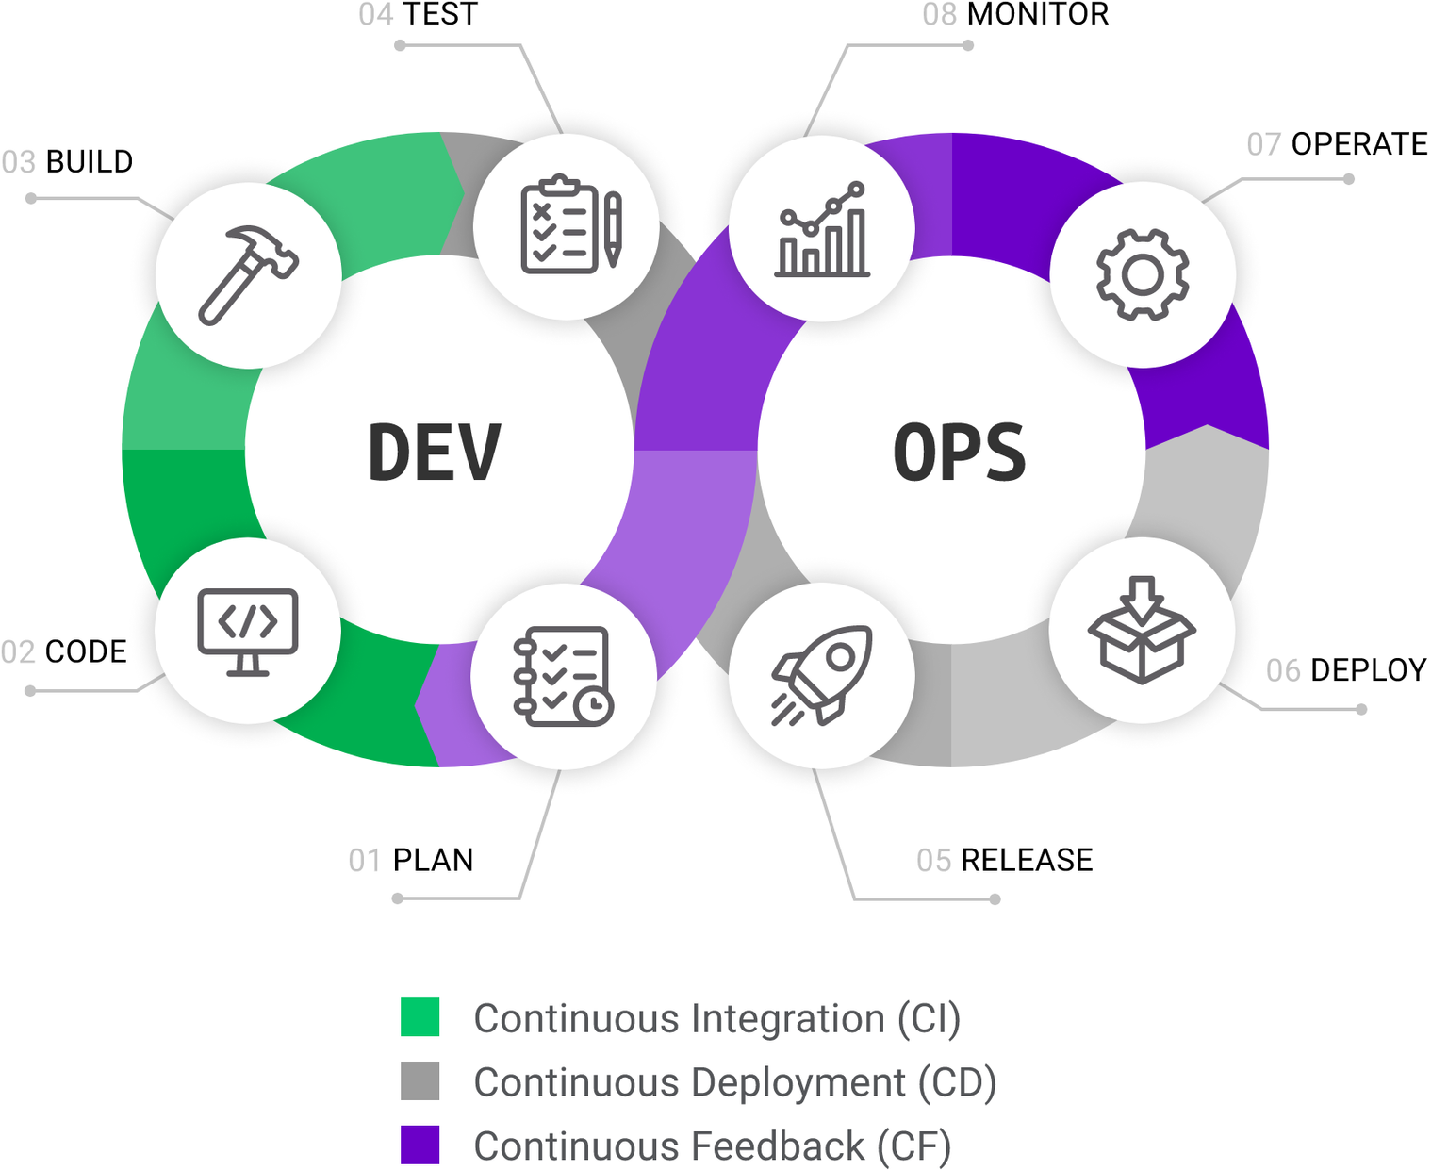
DevOps Lifecycle
PMKK, Guntur

Slide 12
Key Phases in the DevOps Lifecycle:
Plan: Define requirements, features, and scope. Collaborative planning
across teams to align goals and tasks.
Develop: Developers write and test code in short, iterative cycles. Focus
on continuous integration (CI) to ensure smooth integration of new
code.
Build: Code is compiled and built into deployable artifacts.
Automation of build and integration processes ensures
consistency.
Test: Automated testing is run to ensure the quality of the software.
Unit, integration, and performance testing are performed.
PMKK, Guntur

Slide 13
Release: Software is packaged and prepared for deployment. The release process
is automated to minimize manual intervention and reduce errors.
Deploy: Automated deployment to various environments (e.g., staging,
production). Can include rolling updates, blue-green deployments, etc.
Operate : The application is monitored in production. Operations teams ensure
that the infrastructure is stable and performant.
Monitor: Continuous monitoring and logging track application performance and
user feedback. Metrics and real-time data help identify issues early.
Feedback and Continuous Improvement: Continuous feedback from
monitoring, end-users, and automated tests leads to improvements in
code, processes, and infrastructure.
PMKK, Guntur

Slide 14
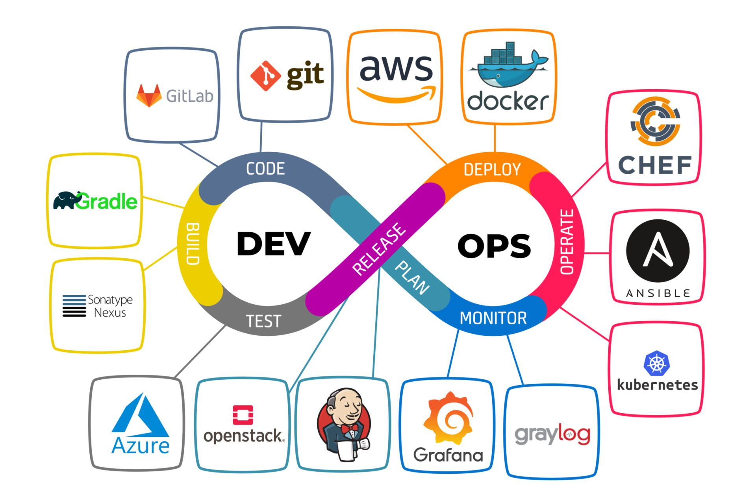
DevOps Tools Overview:
Version Control: Git, GitHub, Bitbucket.
CI/CD: Jenkins, CircleCI, Travis CI.
Configuration Management: Ansible,
Chef, Puppet.
Containerization: Docker, Kubernetes.
Monitoring: Nagios, Prometheus, Grafana.
PMKK, Guntur

Slide 15
Difference Between SRE, DevOps, Cloud Engineer, and Platform Engineer
SRE (Site Reliability Engineer)
Primary Focus:
  Ensures system reliability and availability, with a strong focus on monitoring, automation, and incident response.
Key Responsibilities:
  Reliability: Focus on maintaining high uptime (e.g., SLA/SLO management).
  Automation: Automating repetitive operational tasks.
  Monitoring: Using metrics, alerts, and logs to track system health.
  Incident Management: Actively involved in incident response and post-mortems.
Skills/Tools:
  Monitoring tools (Prometheus, Grafana), automation (Python, Bash), Kubernetes, and observability platforms.
PMKK, Guntur

Slide 16
DevOps Engineer:
Primary Focus:
  Bridges the gap between development and operations, emphasizing continuous integration and delivery (CI/CD) pipelines.
Key Responsibilities:
  Collaboration: Facilitates communication between Dev and Ops teams.
  CI/CD Automation: Implements pipelines for automated testing, integration, and deployment.
  Infrastructure as Code (IaC): Managing infrastructure using code (e.g., Terraform, Ansible).
  Continuous Improvement: Focus on improving processes to accelerate delivery.
Skills/Tools:
  Git, Jenkins, Docker, Kubernetes, Terraform, Ansible, CI/CD platforms.
PMKK, Guntur

Slide 17
Cloud Engineer:
Primary Focus:
  Designs, manages, and supports cloud infrastructure and services (e.g., AWS, Azure, Google Cloud).
Key Responsibilities:
  Cloud Infrastructure Management: Provisioning, scaling, and managing cloud resources.
  Security & Compliance: Ensuring security and compliance within the cloud environment.
  Cost Optimization: Managing cloud cost efficiency and monitoring usage.
  Automation: Automating the cloud resource provisioning and scaling.
Skills/Tools:
  AWS, Azure, Google Cloud, Terraform, Kubernetes, CloudFormation, and container orchestration.
PMKK, Guntur

Slide 18
Platform Engineer:
Primary Focus:
  Builds and maintains internal platforms that support both development and operational workloads.
Key Responsibilities:
  Platform Design: Develops self-service platforms for developers and operations teams.
  Infrastructure as Code (IaC): Manages infrastructure automation to support scalable systems.
  Tooling & Frameworks: Builds and maintains tools that enhance developer productivity (e.g., CI/CD pipelines, monitoring tools).
  Efficiency & Reliability: Ensures that internal tools are reliable and cost-efficient.
Skills/Tools:
  Kubernetes, Docker, CI/CD tools, Terraform, AWS, monitoring solutions.
PMKK, Guntur

Slide 19
Comparison Table
Role | Primary Focus | Key Responsibilities | Skills/Tools
SRE | System reliability and uptime | Incident management, automation, SLA/SLO management, monitoring | Prometheus, Grafana, Kubernetes, Python, Bash
DevOps | CI/CD, collaboration between Dev and Ops | CI/CD automation, Infrastructure as Code, process improvement, collaboration | Jenkins, Docker, Kubernetes, Terraform, Git
Cloud Engineer | Cloud infrastructure management and optimization | Cloud resource provisioning, security, scaling, cost optimization | AWS, Azure, Google Cloud, Terraform, CloudFormation
Platform Engineer | Building internal platforms for development & ops teams | Platform design, IaC, tool maintenance, supporting developer workflows, automation | Kubernetes, Docker, Terraform, AWS, CI/CD tools
PMKK, Guntur

Slide 20
Career Opportunities in DevOps
High Demand: Increasing need for skilled DevOps professionals in both startups
and large enterprises.
Diverse Roles: Opportunities as DevOps Engineers, SREs, Cloud Engineers,
Platform Engineers, and Automation Specialists.
Cross-Disciplinary Skills: Professionals with a mix of coding, system
administration, cloud management, and collaboration skills are
highly sought after.
Attractive Salaries: DevOps-related roles are among the highest-paying in the
tech industry due to the specialized skills required.
Continuous Learning: Ongoing advancements in tools, methodologies, and
cloud technologies mean a career in DevOps offers continuous
growth and opportunities to learn.
PMKK, Guntur

Slide 21
DevOps syllabus as per NSDC
Linux Operating system
  a.Commands
  b. Shell script.
2. GIT & GITHUB
3. Jenkins
4. Docker
5. Kubernetes
6. Ansible
7. MAVEN
8. SonarQube
PMKK, Guntur

Slide 22
Add-on we are offering in Devops course
AWS Cloud Services:
S3
EC2
VPC
RDS
ROUTE53
ACM
CLOUD FRONT
SNS and SQS
CLOUDTRAIL and CLOUD WATCH
IAM
ELASTIC BEANSTALK
EKS
ECR, ECS
PMKK, Guntur

Slide 23

Address:
4/15 th Line, Opp. Punjab & Sindh Bank, Brodipet, Guntur, Andhra Pradesh 522002

Slide 24

PMKK, Guntur

